Slide 1
Computer Vision
Digital Image Formats: An Introduction
Dr. Umberto Michelucci, Dr. Aygul Zagidullina

Slide 2
Raster and Vector images
Raster Images
Image made of pixels
Resolution dependent (cannot be scaled up or down without loss of quality)
Vector Images
Made of lines and curves drawn with mathematical equations (Bezier curves for example, see https://pomax.github.io/bezierinfo/)
Not resolution related
Can be resized without loss of quality
In Deep Learning we work with Raster images.

Slide 3
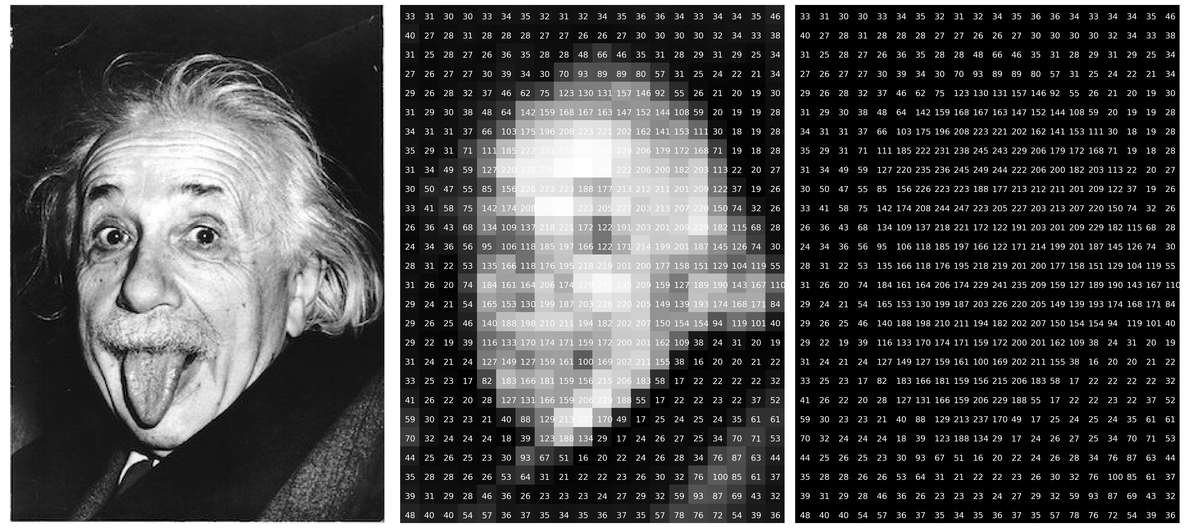
Raster image – an example

Slide 4
Vector images in Deep Learning Research
Vector images are not used to train deep learning models but…
They should be used in publications as they can be scaled and appear very sharp when published on papers or posters (typically in A0 format).
Matplotlib can easily export in vector formats (EPS, PDF, etc.) any figure you generate (https://matplotlib.org/stable/api/_as_gen/matplotlib.pyplot.savefig.html).
Possible Formats: eps, jpeg, jpg, pdf, pgf, png, ps, raw, rgba, svg, svgz, tif, tiff (underline → vector format).

Slide 5
Image features
Resolution (relevant for quality)
Dot per inch (DPI) (relevant for printing)
Compression (relevant for storage and quality)
Transparency
Anti-aliasing
And many more.
For deep learning normally those features (except resolution) are irrelevant.

Slide 6
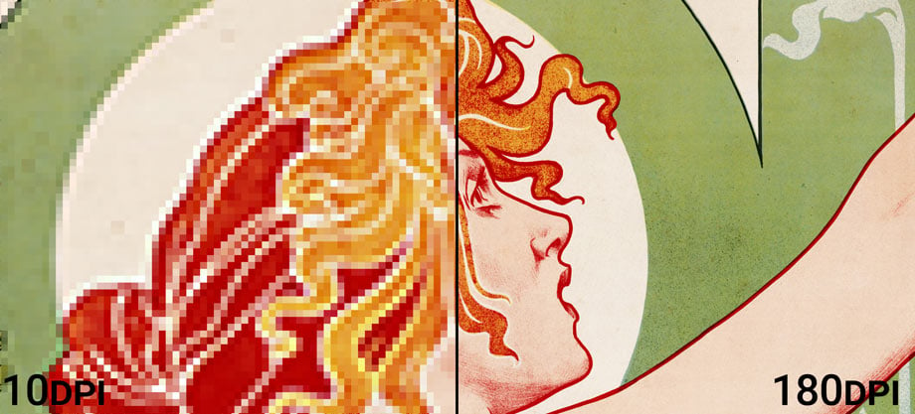
DPI: an explanation
https://prinfab.com/blog/viewing-distance-and-dpi/

Slide 7
Characteristics of images
Image size (storage space)
Image resolution
Number of channels (1 for B&W, 3 for colors in RGB and 4 for CYMK, 4 with transparency)
Color Depth (number of bits to describe the color)
Compression (lossless or lossy)
Specific formats (way in which the information is stored digitally)

Slide 8
Color Depth
Color depth also known as bit depth, is either the number of bits used to indicate the color of a single pixel
When referring to a pixel, the concept can be defined as bits per pixel (bpp)
When referring to a color component, the concept can be defined as bits per component, bits per channel, bits per color (all three abbreviated bpc)

Slide 9
TensorFlow compatible image formats
TensorFlow provides Ops to decode and encode JPEG and PNG formats. It results in a uint8 tensor of shape [height, width, channels]
GIF is understood but results in a uint8 tensor of shape [num_frames, height, width, 3]
You can do all typical operations on images with TF as crop, adjust hue, saturation, resize, etc.
→ This is relevant since the datatypes are all Tensors, thus the code is optimized and no convertions are needed.
https://www.tensorflow.org/api_docs/python/tf/image#:~:text=TensorFlow%20provides%20Ops%20to%20decode,(PNG%20also%20supports%20uint16.)

Slide 10
Colors and Resolution in Deep Learning: some notes
Colors may contain information and thus increase deep learning model performance.
This is not always obvious and needs to be tested.
The optimal resolution needs also to be tested. Large resolution will lead to very slow training.
Almost all pre-trained models expected specific resolution, so resizing is often needed.

Slide 11
Code Discussion

Slide 12
Python libraries for image processing
Pillow/PIL - https://pillow.readthedocs.io/en/stable/
openCV - https://opencv.org/
Scikit-Image - https://scikit-image.org/
Scipy (it does offer some machine learning algorithms, as face detection) - https://scipy.org/
Mahotas - https://mahotas.readthedocs.io/en/latest/
TensorFlow - https://www.tensorflow.org/api_docs/python/tf/image

Slide 13
Computer Vision
CNN Basics
Dr. Umberto Michelucci, Dr. Aygul Zagidullina

Slide 14
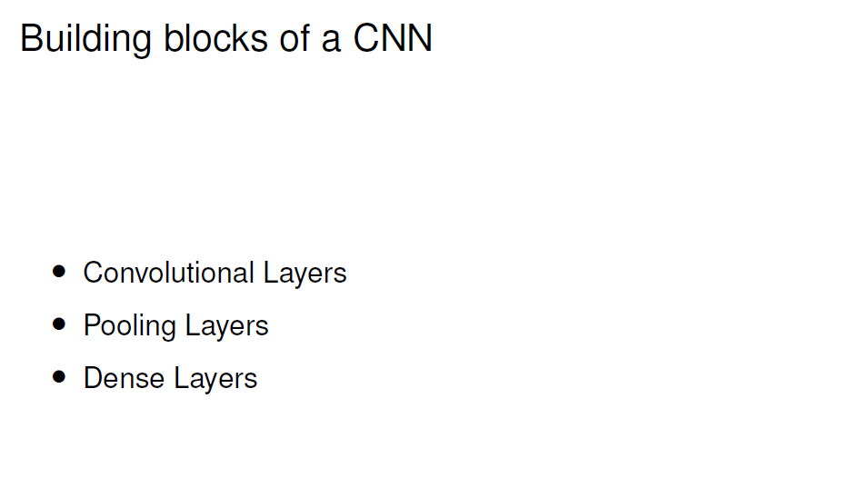
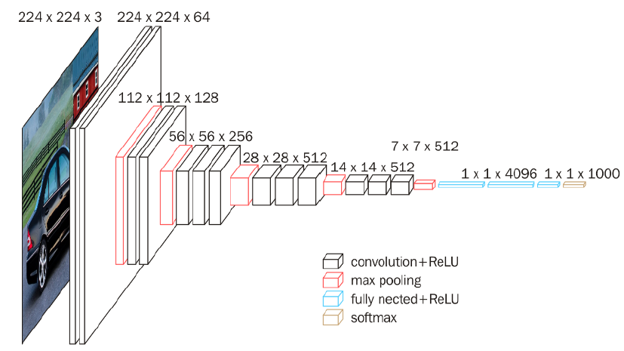

Slide 15
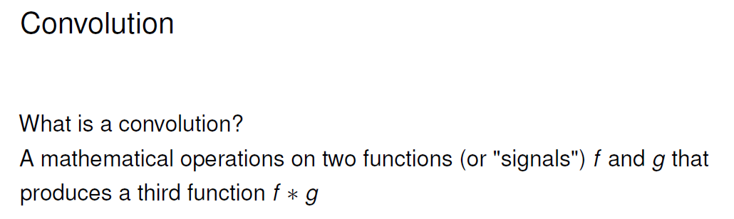
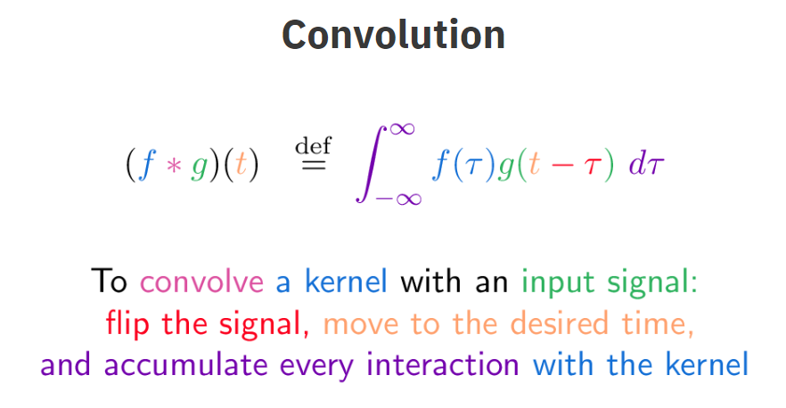

Slide 16
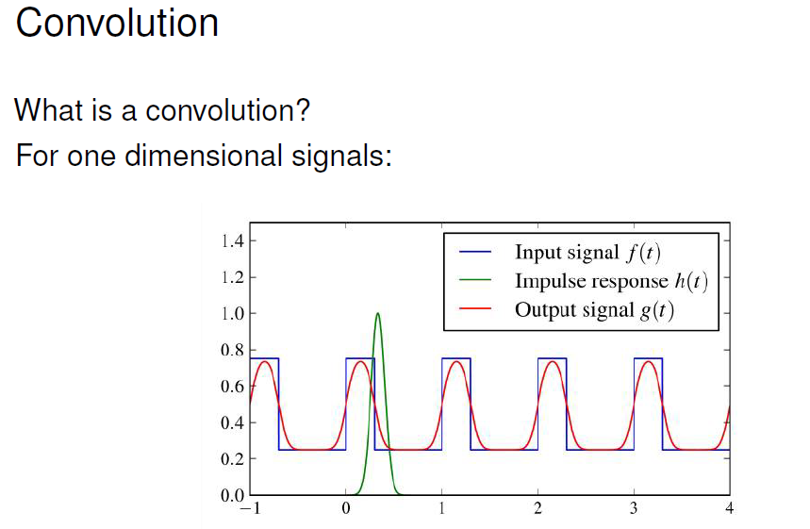

Slide 17
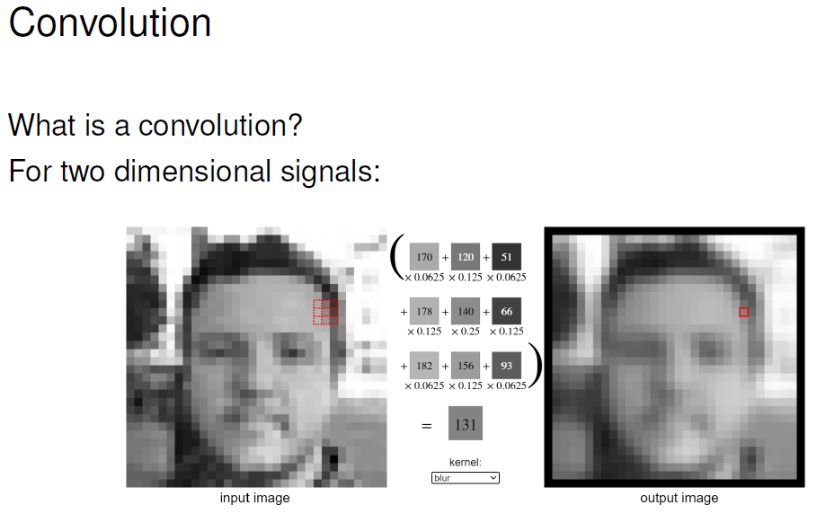
https://setosa.io/ev/image-kernels/

Slide 18
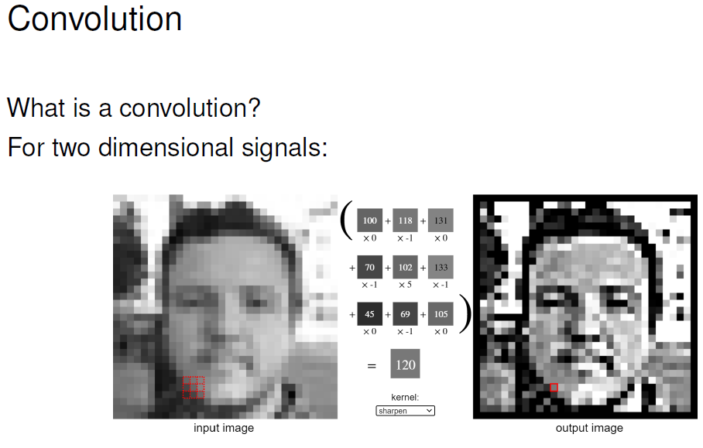

Slide 19


Slide 20
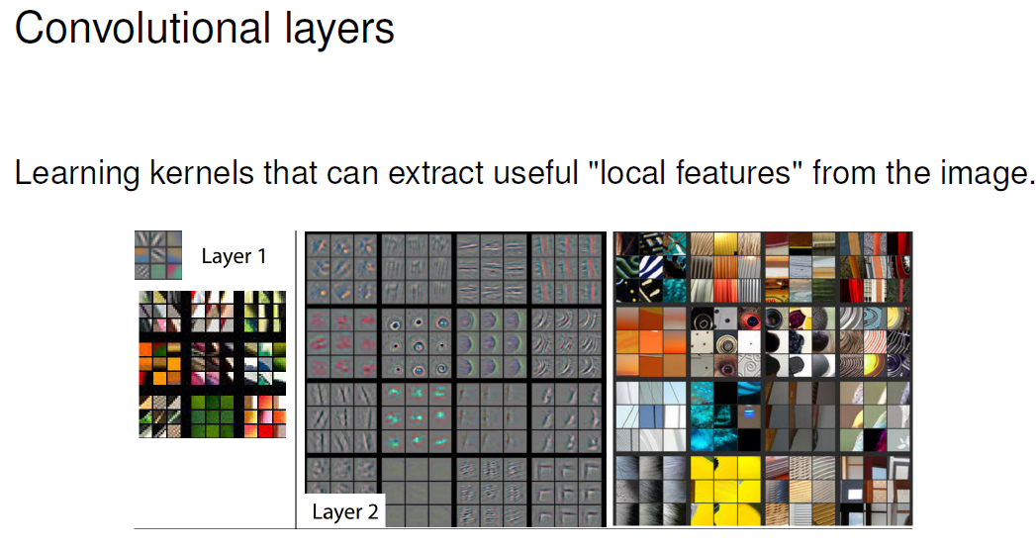

Slide 21
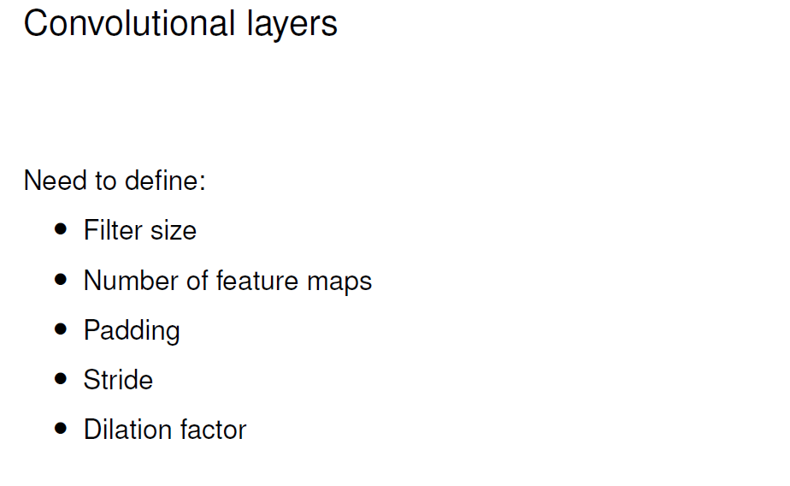
https://github.com/vdumoulin/conv_arithmetic
https://d2l.ai/chapter_convolutional-neural-networks/conv-layer.html
https://stanford.edu/~shervine/teaching/cs-230/cheatsheet-convolutional-neural-networks#layer

Slide 22
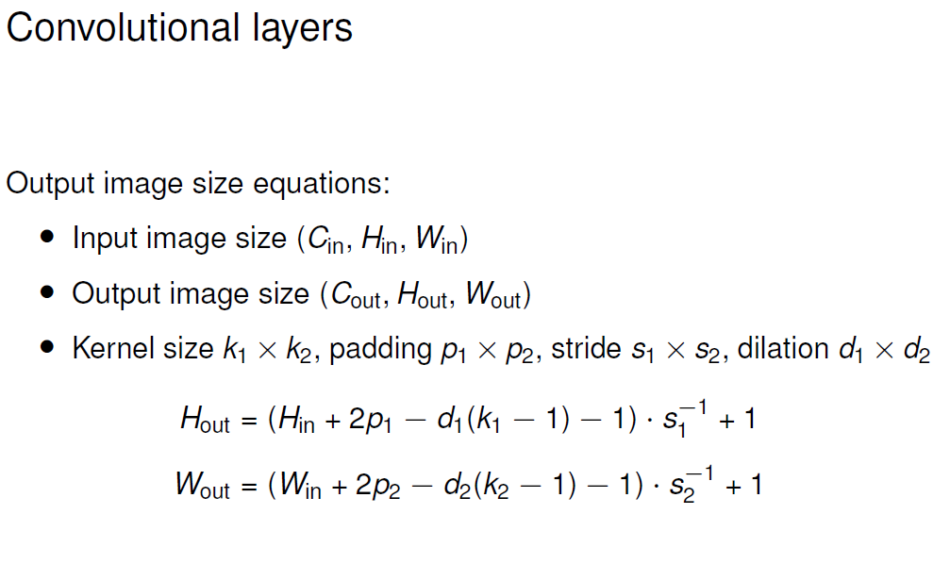

Slide 23
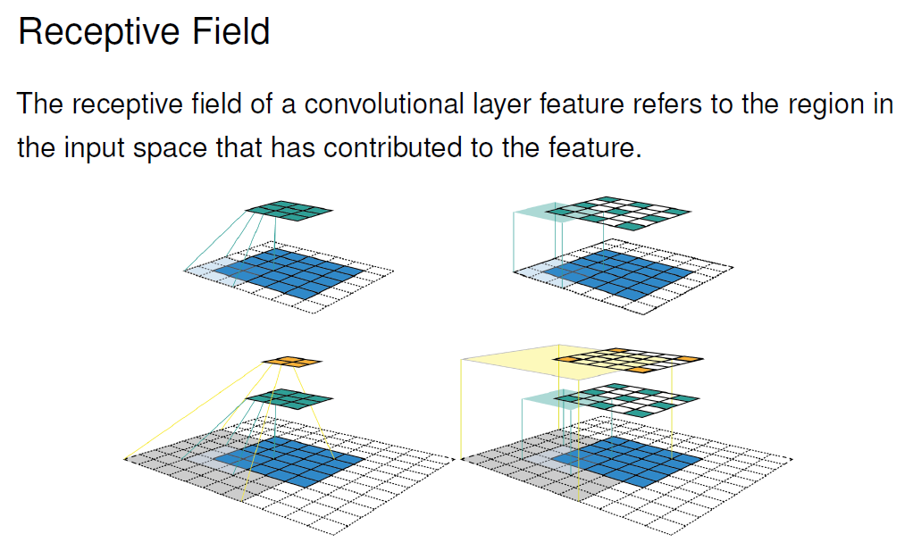

Slide 24
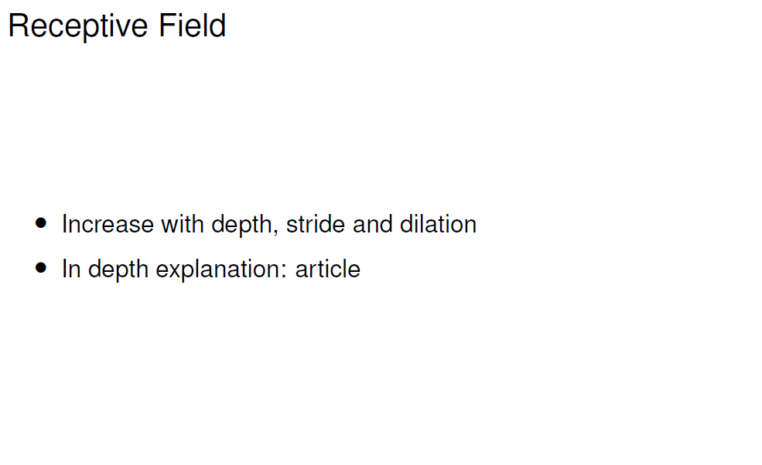
https://blog.mlreview.com/a-guide-to-receptive-field-arithmetic-for-convolutional-neural-networks-e0f514068807

Slide 25
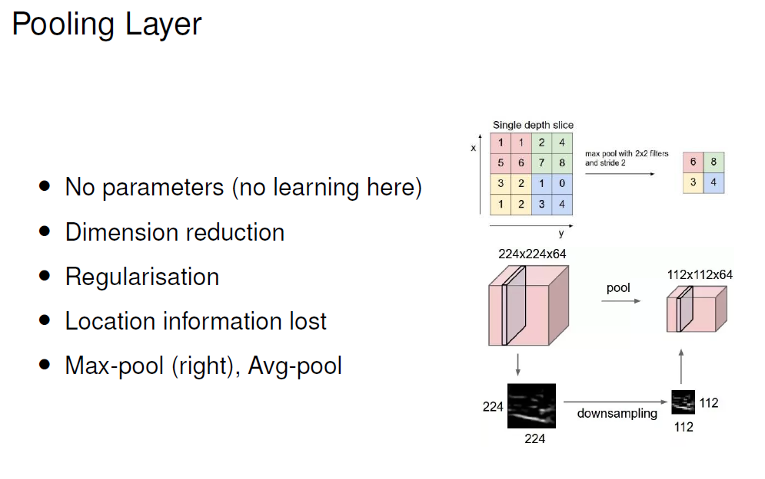

Slide 26
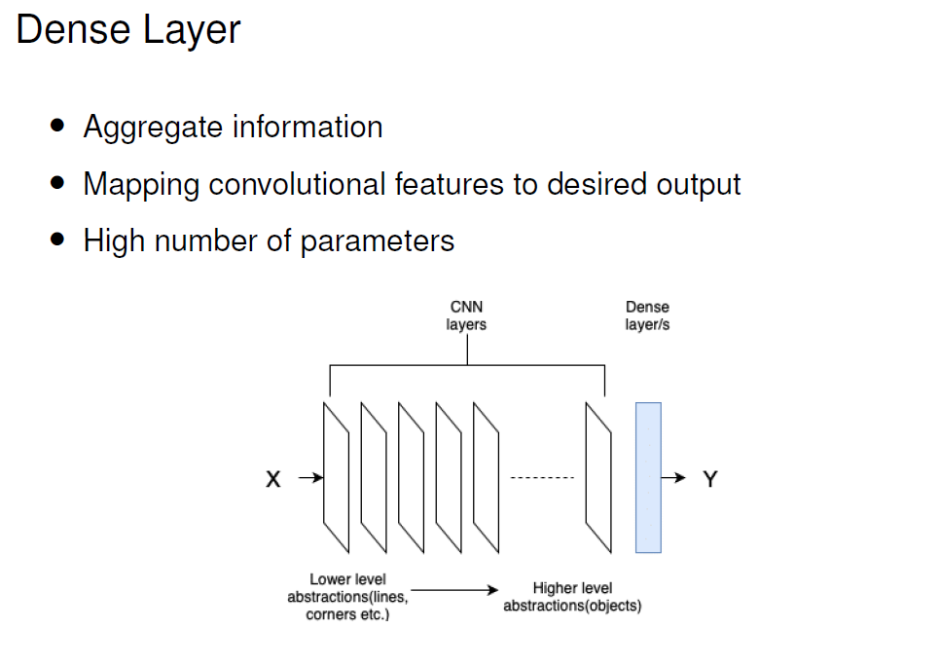

Slide 27
Code Discussion

Slide 28
Computer Vision
Metrics for Image Classification
Dr. Umberto Michelucci, Dr. Aygul Zagidullina

Slide 29
Confusion Matrix (binary classification)
Number of inputs classified as 0 and that have a true class of 0 (TRUE POSITIVES, TP)
Number of inputs classified as 1 and that have a true class of 0 (FALSE NEGATIVES, FN)
In the case of the perfect classifier:
FN = 0 and FP = 0
True Label 0
Number of inputs classified as 0 and that have a true class of 1 (FALSE POSITIVES, FP)
Number of inputs classified as 1 and that have a true class of 1 (TRUE NEGATIVES, TN)
True Label 1
Predicted Label 0
Predicted Label 1

Slide 30
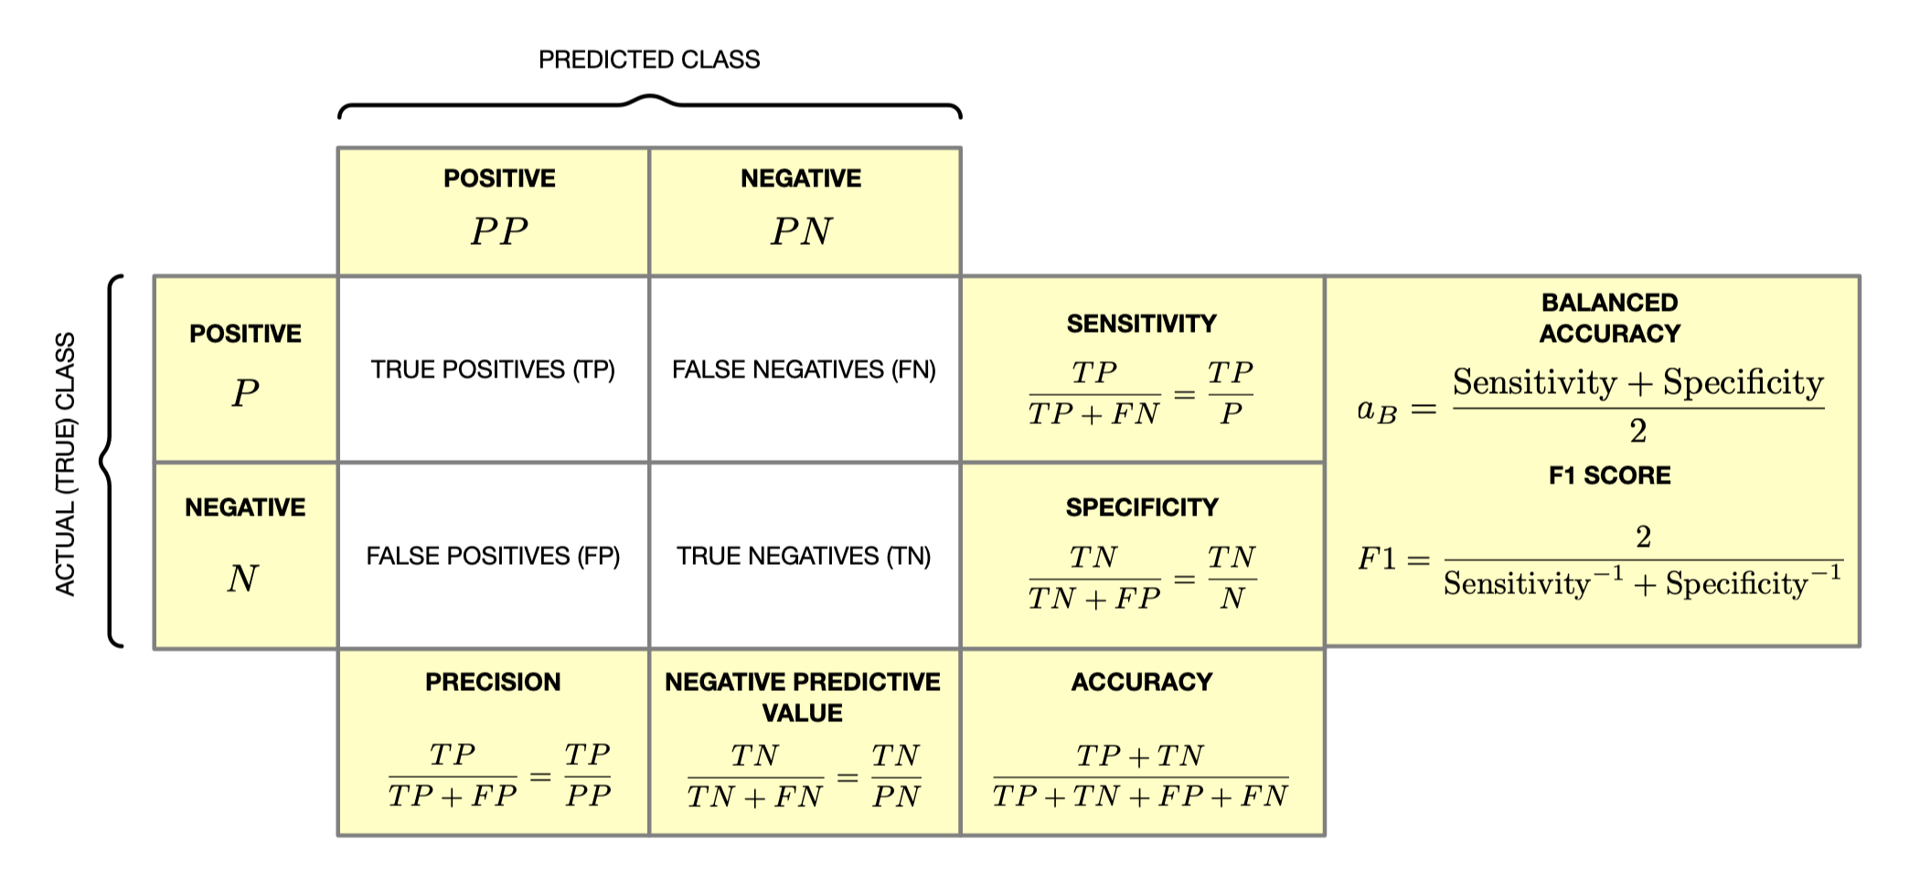
Summary – confusion matrix

Slide 31
Note
All the previos metrics can be used in any segmentation task. You treat each pixel as correctly classified or wrongly classified → So you are dealing with a binary classification problem
But you must be careful when the portion of the image to be segmented is very small. You will easily get high accuracy but the segmentation could be very poor.

Slide 32
Confusion Matrix (Multi-class classification)
Number of inputs classified as 0 and that have a true class of 0
Number of inputs classified as 1 and that have a true class of 0
Number of inputs classified as 2 and that have a true class of 0
…
True Label 0
Number of inputs classified as 0 and that have a true class of 1
Number of inputs classified as 1 and that have a true class of 1
True Label 1
…
…
…
…
…
Predicted Label 0
Predicted Label 1
Predicted Label 2

Slide 33
Computer Vision
Metrics for Image Localization
Dr. Umberto Michelucci, Dr. Aygul Zagidullina

Slide 34
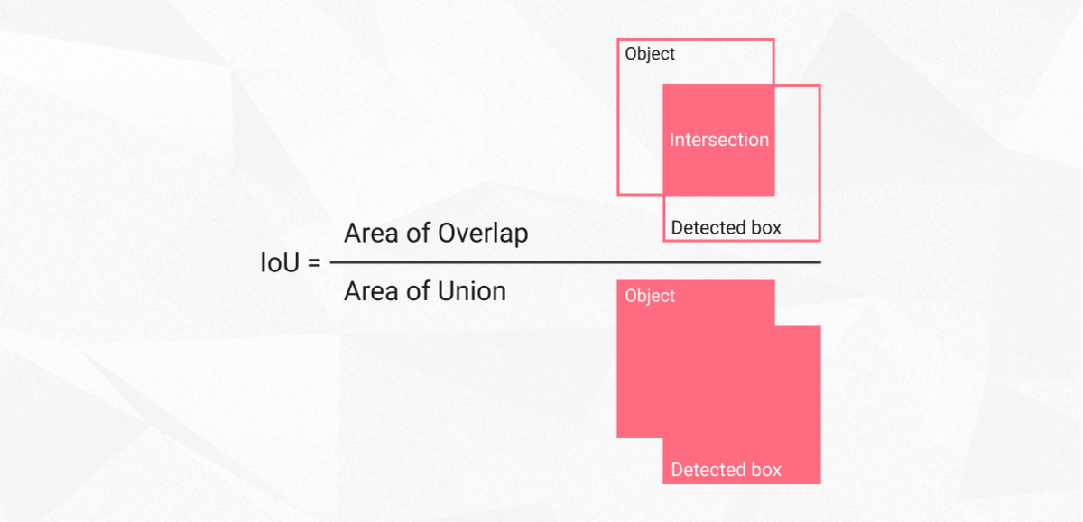
Intersection Over Union (IoU)
Intersection over union is actually a very straightforward and self-explanatory measurement and is based on the Jaccard index (a coefficient for similarity for two sets of data)
https://www.superannotate.com/blog/intersection-over-union-for-object-detection

Slide 35
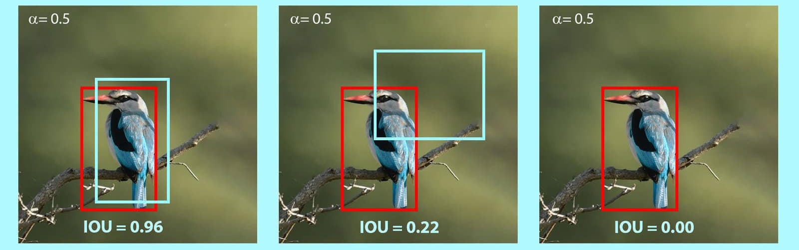
IoU - An example
https://learnopencv.com/intersection-over-union-iou-in-object-detection-and-segmentation/

Slide 36
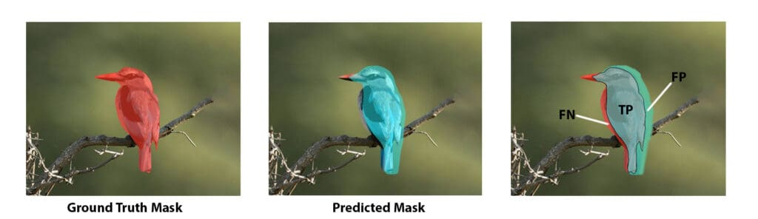
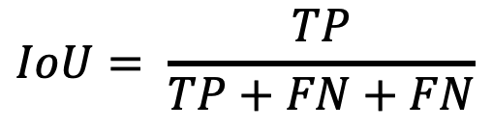
Intersection Over Union (IoU)
$$IoU= \frac{TP}{TP+FN+FN}$$
https://www.superannotate.com/blog/intersection-over-union-for-object-detection

Slide 37
Computer Vision
Transfer Learning
Dr. Umberto Michelucci, Dr. Aygul Zagidullina

Slide 38
Biggest trick in computer vision and deep learning

Slide 39
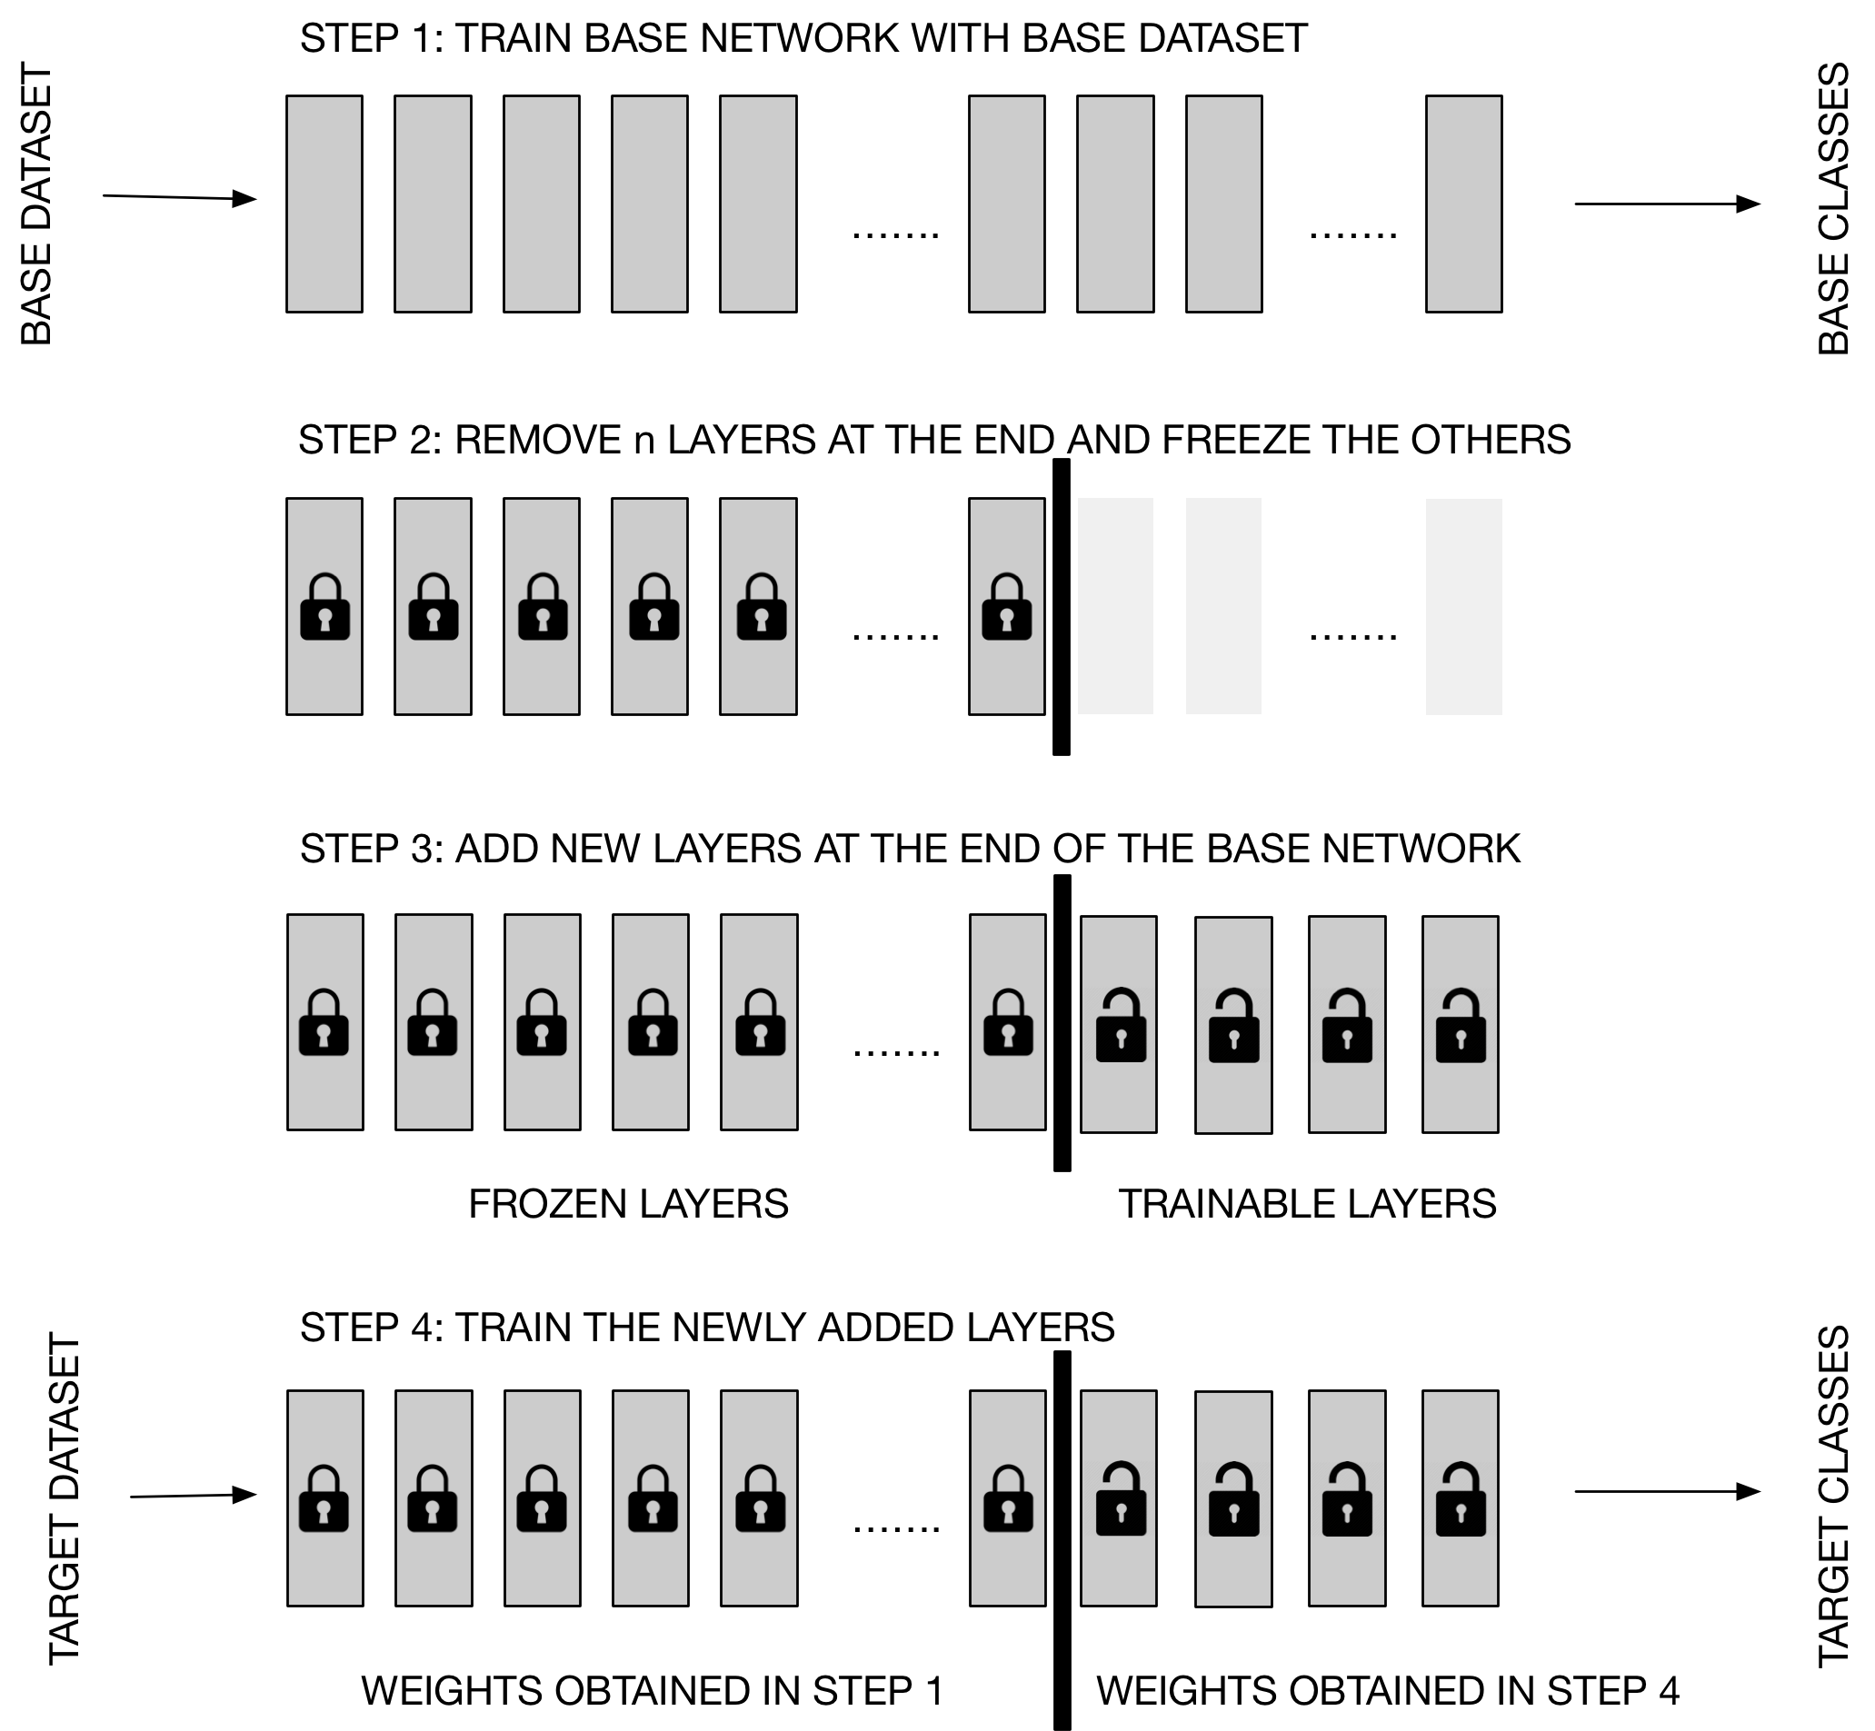
Transfer Learning
Step 1
Step 2
Step 3
In this approach, the entire network has to be trained several times (to tune the hyperparameters). This can be slow.
Step 4
Quelle: Michelucci, U. (2019). Advanced applied deep learning: convolutional neural networks and object detection. Apress.

Slide 40
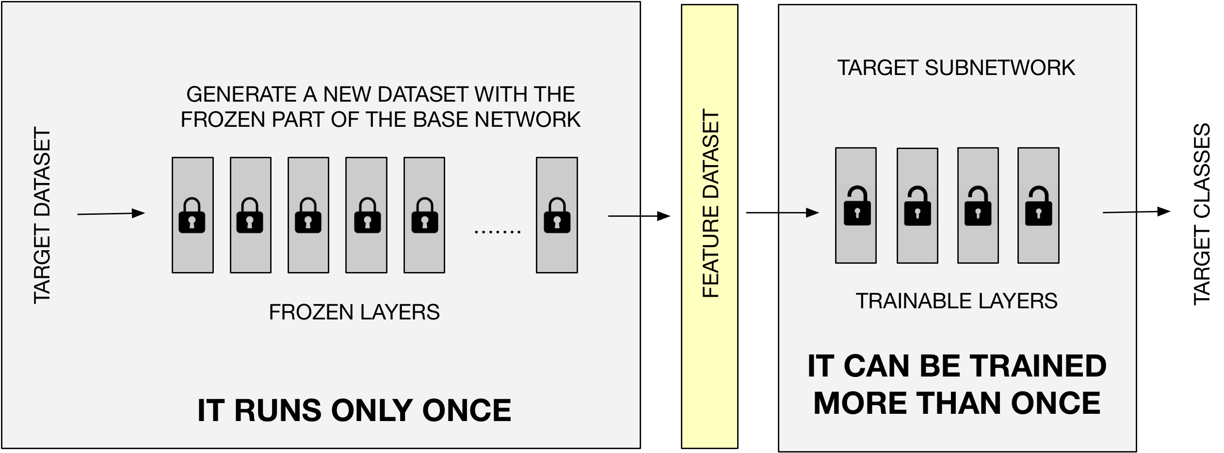
We can make transfer learning more efficient.
Quelle: Michelucci, U. (2019). Advanced applied deep learning: convolutional neural networks and object detection. Apress.

Slide 41
A few numbers (how to become more efficient)
Approach 1 (Naïve)
Approach 2 (Smart)
1 EPOCH → 4.5 minutes
1 EPOCH → 6 seconds
100 EPOCH → 7.5 hours
100 EPOCH → 10 minutes
The numbers come from a test with a "dog/cat" image dataset of about 800 MB. All information can be found in Michelucci, U. (2019). Advanced applied deep learning: convolutional neural networks and object detection. Apress.

Slide 42
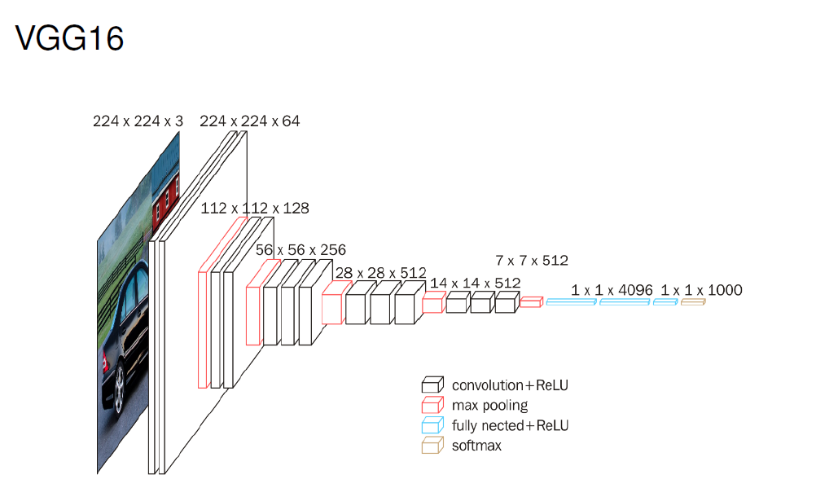
Original Paper: https://arxiv.org/pdf/1409.1556

Slide 43
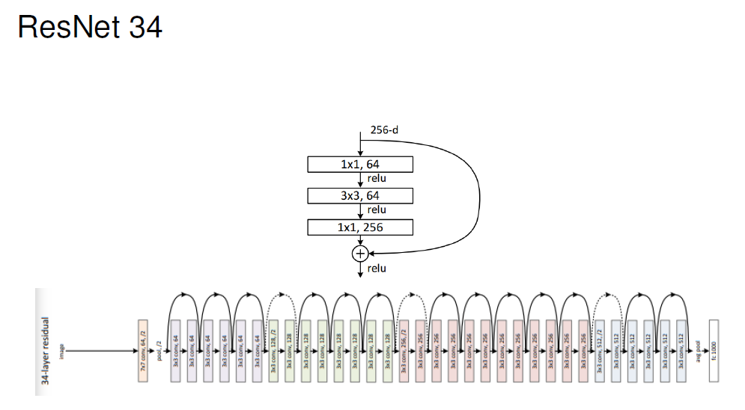
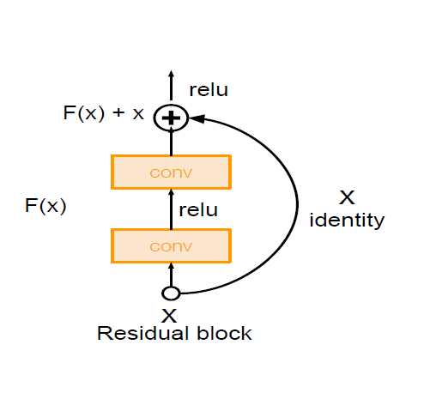
Original Paper: https://arxiv.org/abs/1512.03385

Slide 44
Code Discussion

